Slide 1
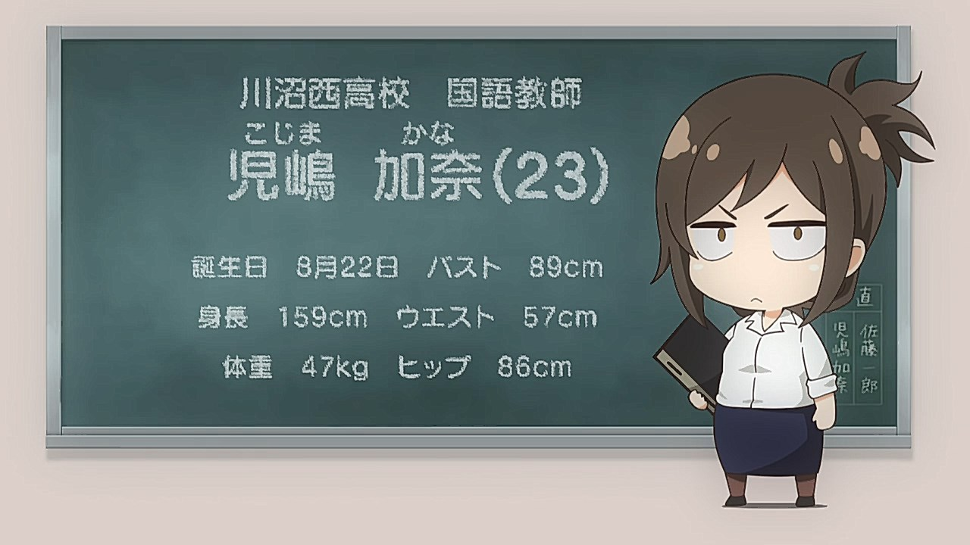
Storage Solutions 101
By yours truly: Tyche (Jun Hao)

Slide 2
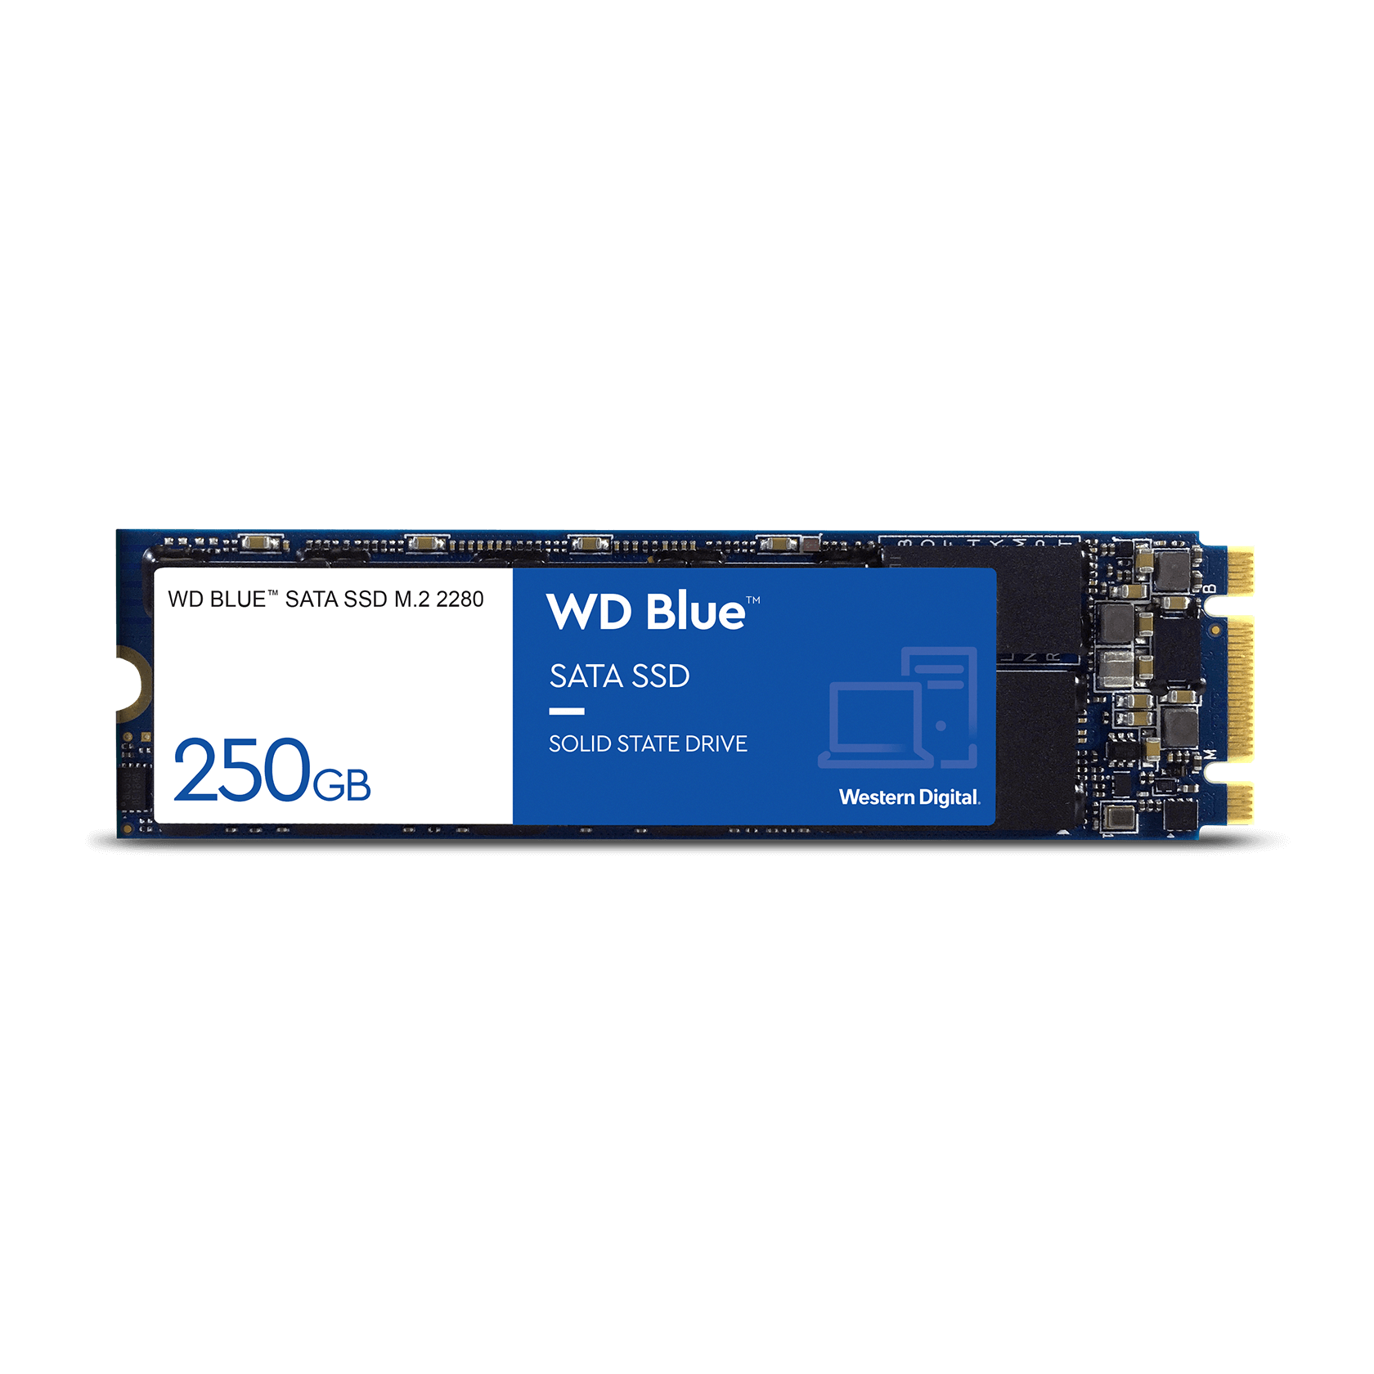
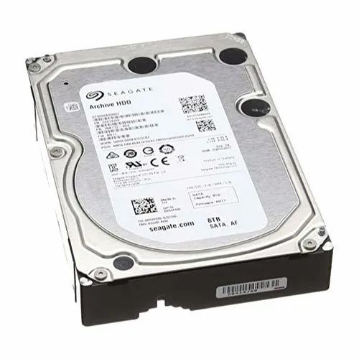
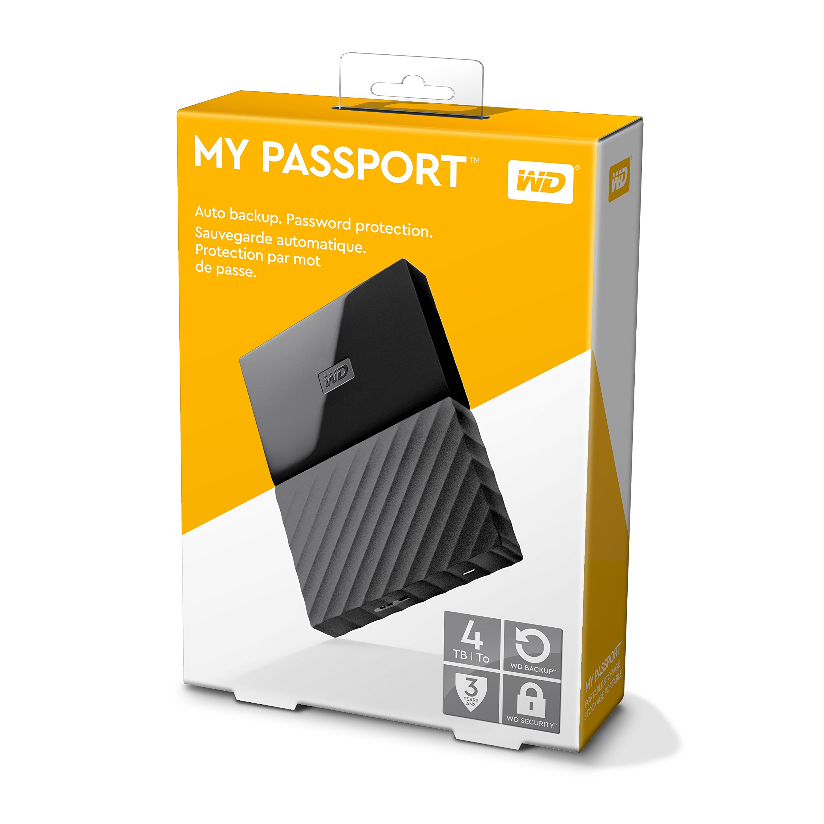
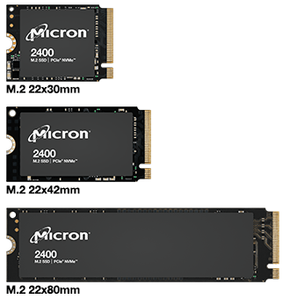
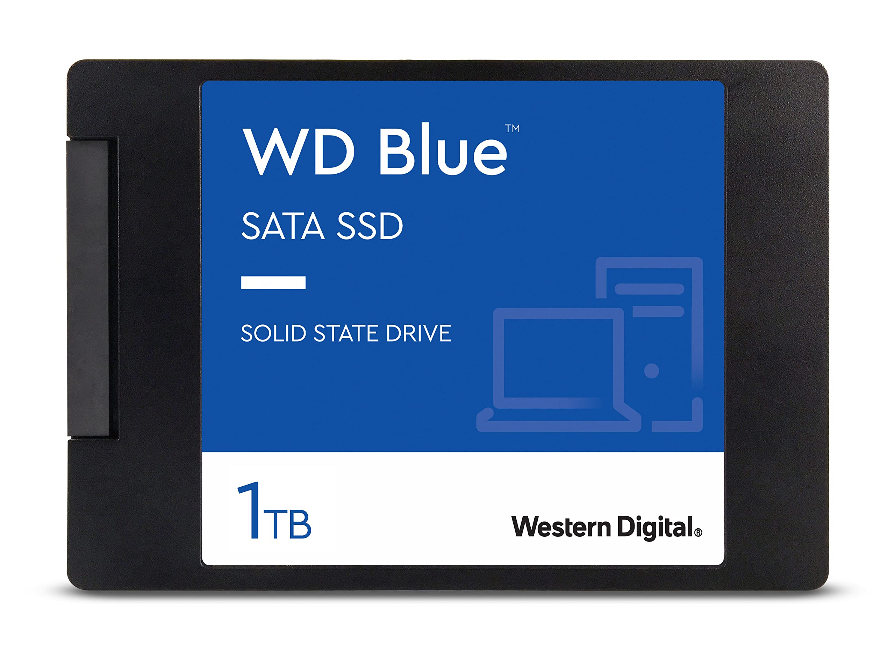
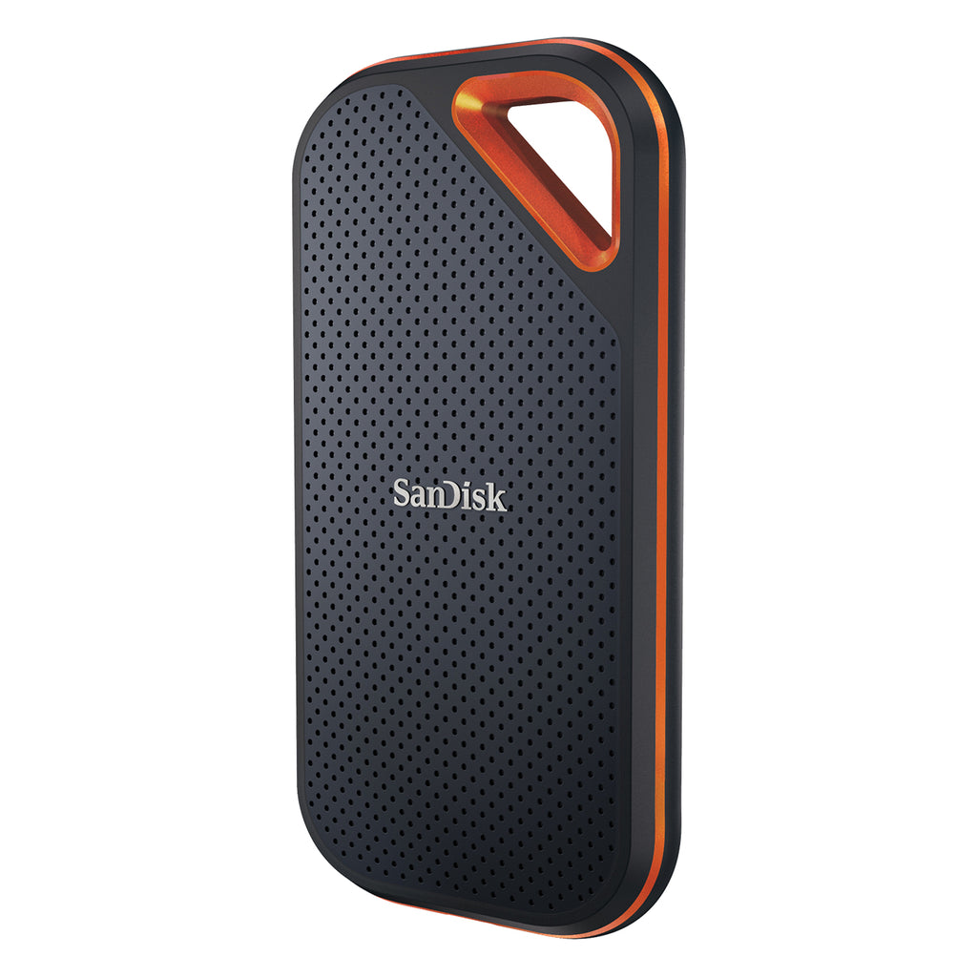
6 Kinds of Storage Solutions in the Market (as of 2023)
1) Internal Hard Drive (Sata)
4) Internal Solid-State Drive (M.2 Sata)
5) Internal Solid-State Drive (M.2 NVME)
2) External Hard Drive (USB A / USB C)
3) Internal Solid-State Drive (Sata)
6) External Solid-State Drive (USB A/ USB C)

Slide 3
Internal Hard Drive (Sata)
AKA HDD
How to recognize & find? - Usually comes in a few standard formats (2.5inch and 3.5inch)
- Looks very barebones and intimidating (as seen in the picture)
- HEAVY
- Go google “Internal Hard drive 2.5/3.5 [Storage size]”
What is this suitable for?
- People who want LARGE storage for a reasonable price for their Desktop PCs
- People who are on a budget
- People who don’t care about speed of storage
- People who don’t mind tinkering around their Desktop / Laptops
What is this NOT suitable for?
- People who own laptops* and want to upgrade their storage solution
- People who wants fast read and write speeds for their workflow
- Sound sensitive environments (when reading and writing)
- People who fears failure rates / corrupted data potential **
* = Most older laptops do support internal 2.5inch sata, do check laptop manufacture date and motherboard support before pulling the plug
** = Some premium Hard drive solutions (for CCTV or system backup servers) do offer lower hardware failure rates, but most consumers are not looking at those offerings.

Slide 4
External Hard Drive (USB A / USB C)
AKA HDD
How to recognize & find? - Comes in all shapes and sizes, but usually most of them base off the 2.5inch size guide
- Usually sells with a USB A / USB C connection with them (Inside the box)
- Always on sale for students
- Go google “External hard drive [Storage size]” and look out for those Dirt-Cheap ones
What is this suitable for?
- People who want LARGE storage for a reasonable price for their Desktop PCs / Laptops
- People who are on a budget
- People who don’t care about speed of storage
- People who wants to bring their storage AROUND (Portable!)
What is this NOT suitable for?
- People who wants fast read and write speeds for their workflow
- Sound sensitive environments (when reading and writing)
- People who fears failure rates / corrupted data potential *
* = External Hard Drives tend to have a higher failure rate compared to Internal Hard drives due to portability nature

Slide 5
Internal Solid-State Drive (Sata)
AKA SSD
How to recognize & find? - The only format (That I know of) is 2.5inch size Sata SSDs
- Usually VERY VERY Light (due to it not having any moving mechanisms)
- This solution was very popular in the mid 2014 – 2018s
- Go google “Sata SSD [Storage Size]” and look for the flat squarish ones
What is this suitable for?
- People who have a Laptop or PC from that era ONLY HAS SATA based connections
- People who wants to upgrade their relatively old systems (From Hard Disk To SSD)
- People who wants to DIY portable external SSDs for cheap*
What is this NOT suitable for?
- People who have VERY modern systems (2019 and newer**) with newer storage connection solutions available to them (M.2 NVME)
- People who are on a very VERY tight budget
* = Refer to the last slide on how to DIY a Portable SSD
** = Please do research whether your system does support NVME connection first or not, Do a quick google + “Does it have NVME” to see results.

Slide 6
Internal Solid-State Drive (M.2 Sata)
AKA SSD
How to recognize & find? - The most misleading mfker in existence for newcomers, looks like NVME SSD
- Take note of how the connecting pins look like, 3 point of contact like a trident.
- Very small, light and flat, like the size of a vape / E-cigarette
What is this suitable for?
- ALMOST NOBODY (Unless your system came from the weird transition era from 2016 to 2018 where it had this weird ass M.2 SATA connection. (Higher chance on Desktop PCs)
What is this NOT suitable for?
- Almost everyone, Just do a quick google check your device support, if it doesn’t just ignore this completely.

Slide 7
Internal Solid-State Drive (M.2 NVME)
AKA SSD
How to recognize & find? - Every technician favorite child to upsell you on, they will nonstop talk about it
- Same as M.2 SATA, flat and small.
- Comes in 3 sizes and seen below, premium ones do come with heat sinks preinstalled and cheaper ones usually wont.
What is this suitable for?
- People who wants the current era of fastest storage read and write speeds*
- People looking for a storage upgrade solution for their modern systems (PS5, Laptop and Desktops)
- People who have a more relaxed range of budget to work with**
- People who wants to DIY portable external SSDs for cheap***
What is this NOT suitable for?
- People with older systems that DO NOT support NVME connections
- People who are on a really tight and controlled budget needing big storage solutions
* = NVME SSD currently has 3 generations (Gen 3, Gen 4 and Gen 5). With each generation having different bandwidth support, check your device max NVME bandwidth support before pulling the plug to purchase in order not to waste $$$.
** = 3 generations of NVME SSD have different prices for same storage size, for example a 1TB gen 5 NVME SSD could cost as much as a 2TB gen 3 NVME SSD.
*** = Refer to the last slide for how to DIY a portable SSD.

Slide 8
External Solid-State Drive
AKA SSD
How to recognize & find? - Comes in a HUGE range variety of shapes and sizes (Due to it using flash chips)
- Usually, the MOST expensive SSD solution if you are not buying during sale
- Go google “External SSD [Storage size]” and look out for something nice looking like the one in the picture or something with a complete body look.
What is this suitable for?
- ALL IN ONE solution for people who wants to upgrade their storage size without tampering with their system
- People who wants fast read and write speeds but don’t really care about having the best.*
- People who have big budgets and want their storage to be portable
What is this NOT suitable for?
- People looking for a bang for buck solution
- People whose computer systems (Laptop or Desktops) connections don’t really support fast read and write speeds**
* = Some external SSDs do claim to have blazing fast speeds, even faster than some gen3 NVME solutions. BUT DO THAKE THEIR CLAIMS WITH A GRAIN OF SALT. It is marketing fluff at the end of the day.
** = Some systems have a cap (max) read and write speeds set to very low due to bandwidth limitations in their system. Do check your device manufacture support before pulling the plug on a premium external SSD solution.

Slide 9
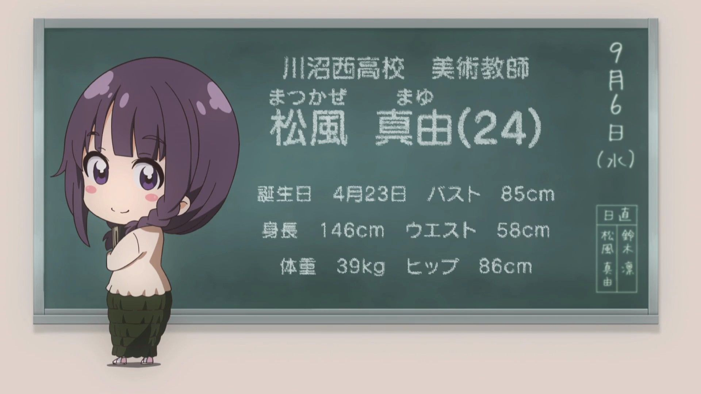
DIY EXTERNAL SSD

Slide 10
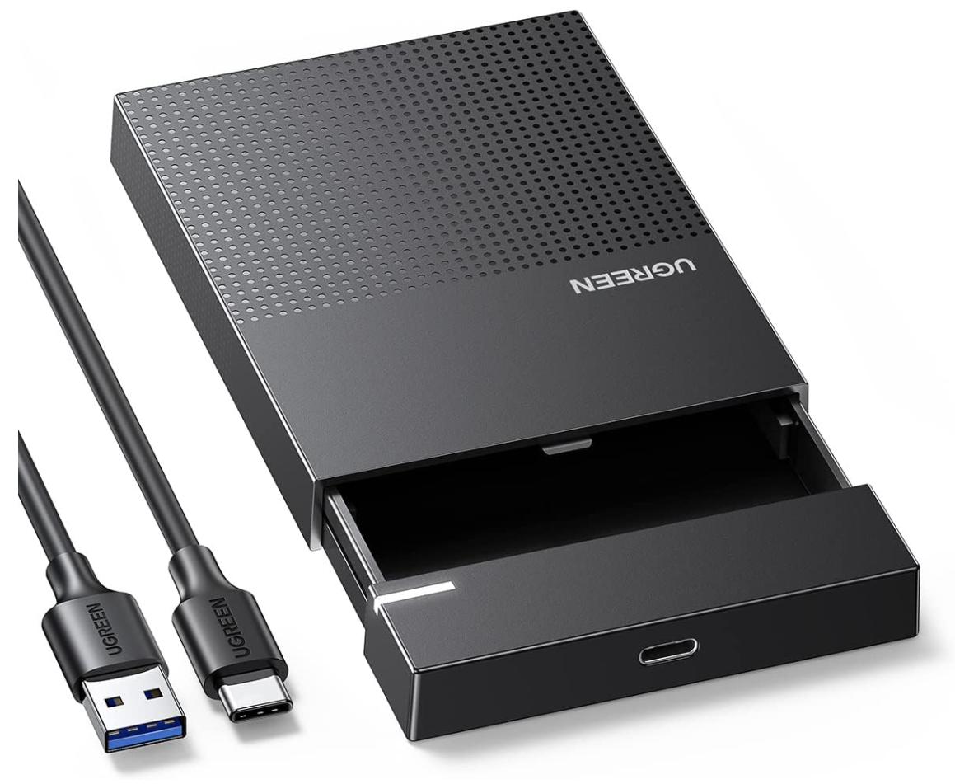
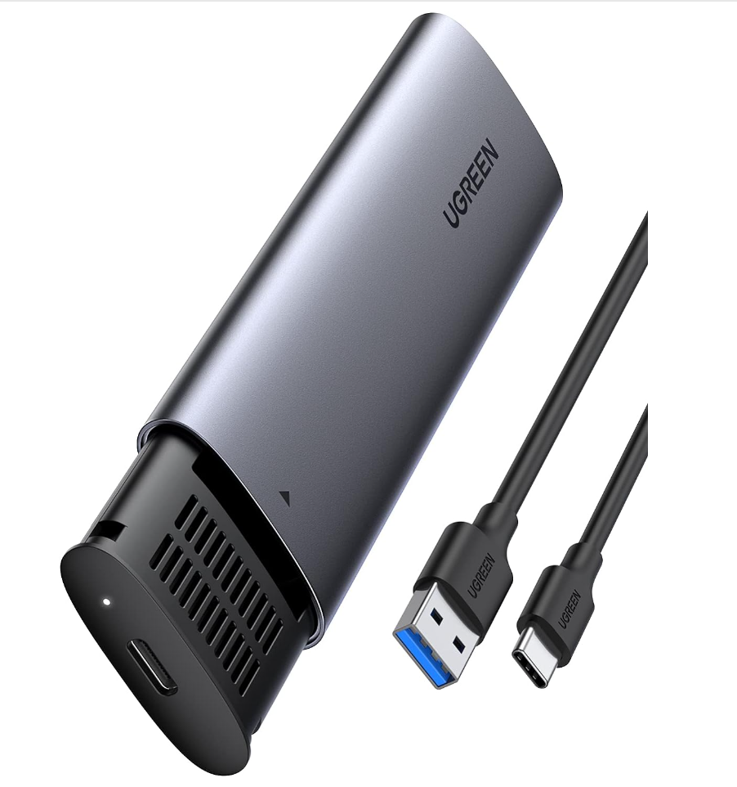
“I want to DIY my external SSD!”
“I have a … ”
“I have a … ”
*
**
“Therefore, I should get a …”
“Therefore, I should get a …”
* = link to external closure as seen in the picture : https://www.amazon.sg/UGREEN-Enclosure-External-Supported-Compatible/dp/B0963DGJSJ/ref=sr_1_8?crid=RD4AQW350292&keywords=Sata+external+closure&qid=1699517024&sprefix=sata+external+closure%2Caps%2C273&sr=8-8
** = link to external closure as seen in the picture :
https://www.amazon.sg/UGREEN-Enclosure-Tool-Free-Thunderbolt-Compatible/dp/B09T97Z7DM/ref=sr_1_1?crid=20FQ55ECNGH1H&keywords=ugreen+m.2+nvme+ssd+enclosure&qid=1699517294&refinements=p_n_prime_domestic%3A7993547051&rnid=7993546051&sprefix=ugreen+m.2+%2Caps%2C253&sr=8-1

